Slide 1
5 Reasons your indexed pages are dropping

Slide 2
What does Google indexed pages mean?
Getting your pages indexed by Google and other search engines is vital. None indexed pages can’t rank. indexing is the process of adding pages into Google search. Depending on the meta tag used (index or NO-index), Google crawls and indexes your pages. A no-index tag means that the page will not be added to the search's index. By default, every WordPress pages and posts are indexed.

Slide 3
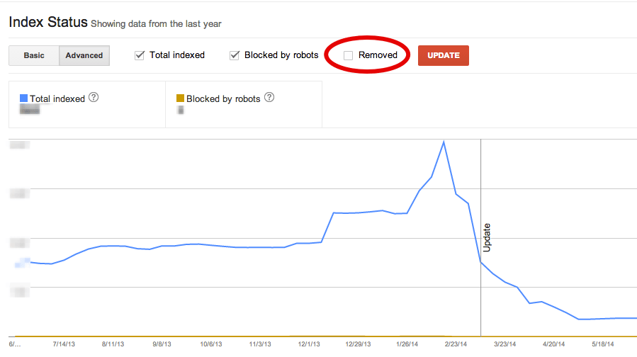
How can you see how many pages are indexed?
You can use the site: operator.
Check the status of the XML Sitemap Submissions on Google Search Console.
Also, Check your overall indexing status.

Slide 4
Why is Google not indexing your site?
This is/ might be because your site is new and doesn't have any inbound links. You should first, create an account on the search console. When you register and point Google to your sitemap. XML URL, you can then request them to re-crawl your URLs.
If your indexed page count begins to decrease, it could be because:
You are slapped with a Google penalty.
Google may be thinking your pages are irrelevant.
Google cannot crawl your pages.

Slide 5
5 Reasons your indexed pages are dropping
Are your Pages Loading Properly?
Did You change URLs?
Fix Duplicate Content Issues
Are Your Pages Timing Out?
Is the Search Engine Bots looking at Your Site Differently?

Slide 6
1. Are your Pages Loading Properly?
Your pages must have a proper 200 HTTP Header Status.
Action Plan:
You may use a free HTTP Header Status checking tool to check if you have a proper status. Well in our case we use screaming frog and Xenu.
2. Did You change URLs?
Sometimes a change in backend programming or the server setting that results in a change in domain or folder may consequently change URLs of the site. Search engines can remember the old URLs however if they are not redirected properly, pages can become de-indexed.
Action
Visit the previous site and take note of all old URLs to map out the 301 redirects to the corresponding URLs.

Slide 7
Cont…
3. Fix Duplicate Content Issues
To fix duplicate content includes applying canonical tags, 301 redirects, and no-index meta tags, or even disallows in robots.txt. All of which can then result in a decline in the indexed URLs.
Action
double-check the definite cause of the decrease of indexed pages and not anything else.

Slide 8
Cont…
4. Fix Duplicate Content Issues
To fix duplicate content includes applying canonical tags, 301 redirects, and no-index meta tags, or even disallows in robots.txt. All of which can then result in a decline in the indexed URLs.
Action
double-check the definite cause of the decrease of indexed pages and not anything else.

Slide 9
Cont…
5. Is the Search Engine Bots looking at Your Site Differently?
Most of the times what search engine spiders see is maybe different from what we see. Developers tend to build sites in a more preferred way without knowing the SEO inferences. Sometimes, it may have been done on purpose by an SEO in an attempt to do content cloaking, to play the search engines.
Action
Use web Search Console’s fetch and render tool to see if Googlebot sees the same content as you are.

Slide 10
A Decrease in the Indexed Pages Is not Always Bad
A decrease in indexed pages might mean a bad thing most of the time, however a fix to duplicate content, low-quality content, thin content may also result in a declined number of indexed pages, which is a good thing.

Slide 11
Sources
https://www.searchenginejournal.com/technical-seo/indexed-pages-decrease/
https://www.quora.com/Why-are-my-Google-indexed-pages-dropped
https://www.rankranger.com/seo-glossary/indexed-pages

Slide 12
Everyday Task
Always check your sites/pages on Xenu and Screaming frog and fix errors

